Slide 1
FACTOR ANALYSIS

Slide 2
First, let’s check the reliability of the scale
Go to
Analyze,
Scale and
Reliability analysis

Slide 3
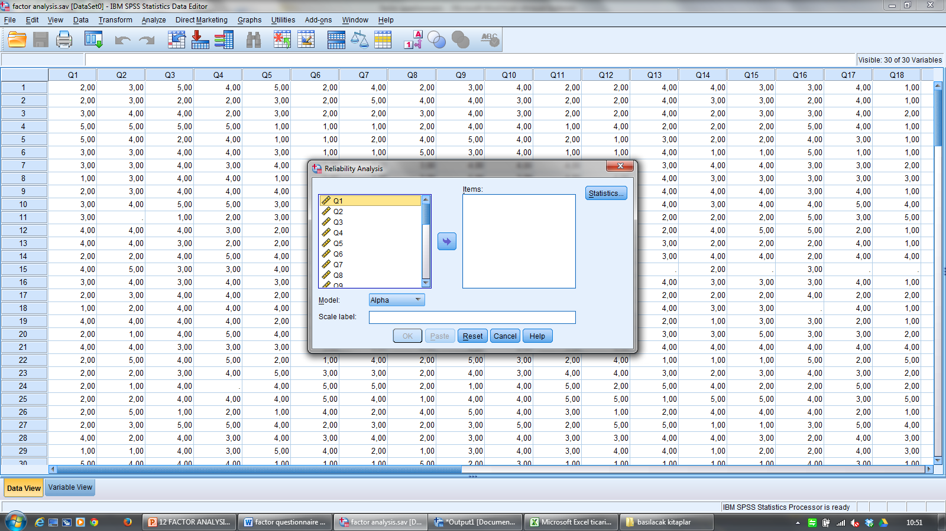

Slide 4
Select the items and transfer them into the box on the right (under ‘ Items)

Slide 5
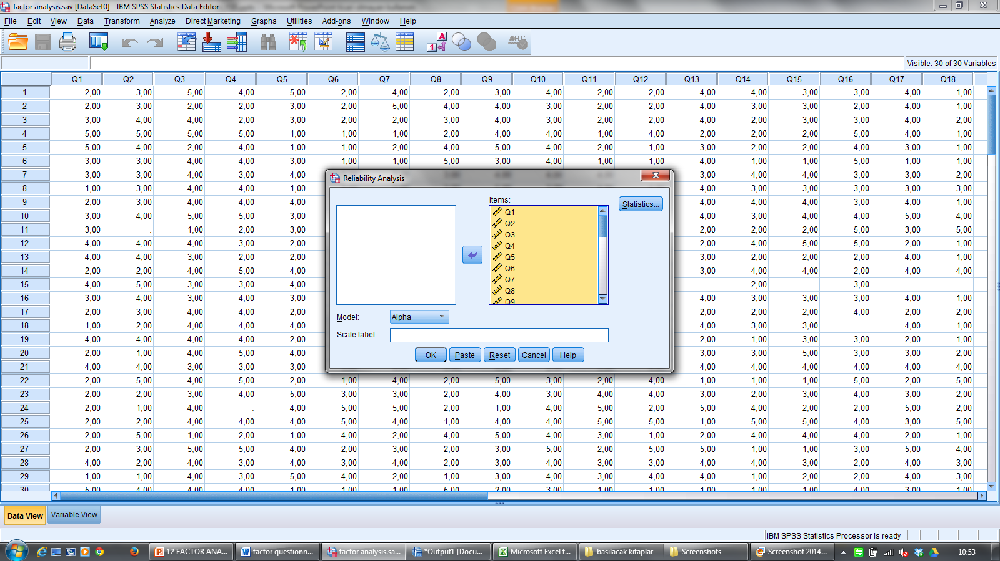

Slide 6
Click on Statistics and select the analysis that you need:
Item
Scale
Scale if item deleted
Correlations
Means, etc

Slide 7
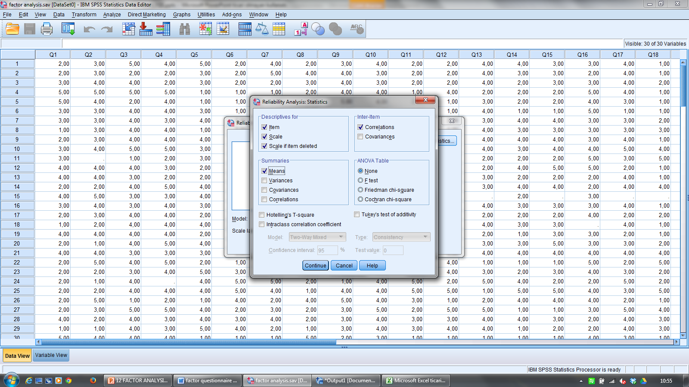

Slide 8
Then click continue, and then OK
You will see the output and the analysis you asked for
Look at Alpha

Slide 9
Reliability Statistics
Cronbach's Alpha | Cronbach's Alpha Based on Standardized Items | N of Items
,722 | ,728 | 30
Acepted to be reliable

Slide 10
Alpha is over .70 so it is reliable enough.
No need to delete an item
But let’s see if deleting an item will make the alpha much higher

Slide 12
Factor Analysis
When do we need factor analysis?
to explore a content area,
To structure a domain,
To map unknown concepts,
To classify or reduce data,
To show causal relationships,
To screen or transform data,
To define relationships,
To test hypotheses,
To formulate theories,

Slide 13
Two Aproaches
1. Exploratory factor analysis (EFA)
It is used to uncover the underlying structure of a relatively large set of variables.
The goal is to identify the underlying relationships between measured variables.
It is commonly used by researchers when developing a scale and serves to identify a set of latent constructs underlying a battery of measured variables.
It should be used when the researcher has no a priori hypothesis about factors or patterns of measured variables.

Slide 14
2. Confirmatory factor analysis (CFA)
It is used to test whether measures of a construct are consistent with a researcher's understanding of the nature of that construct (or factor).
The objective of confirmatory factor analysis is to test whether the data fit a hypothesized measurement model.
This hypothesized model is based on theory and/or previous analytic research.
In CFA, the researcher first develops a hypothesis about what factors s/he believes are underlying the measures s/he has used and may impose constraints on the model based on these a priori hypotheses

Slide 15
Using factor analysis in SPSS (EFA)
Step 1.
Go to Analyze
Select Reduction (Dimension Reduction)
Select Factor

Slide 16
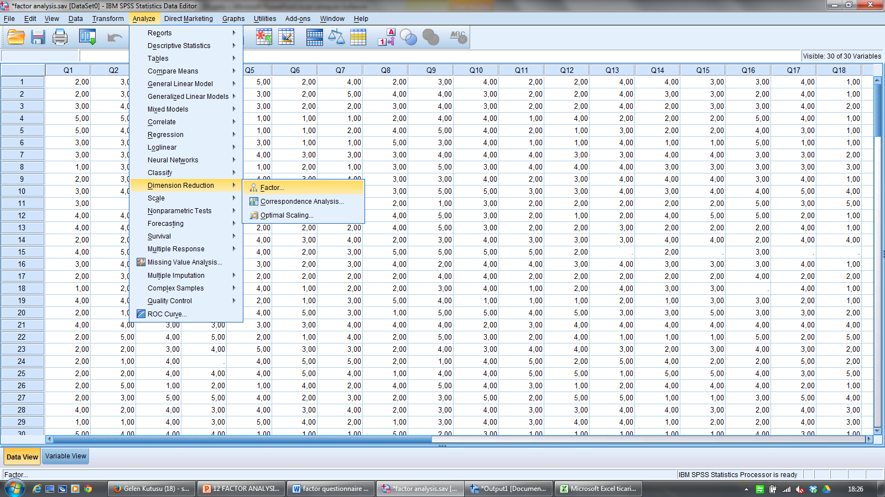

Slide 17
Step 2.
Select the variables and transfer them to Variables box

Slide 18
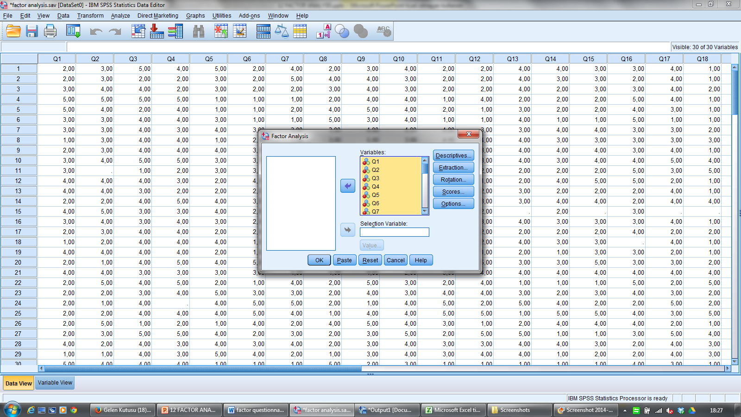

Slide 19
Step 3.
Select Descriptives
Click on the statistics that you need
E.g.
Coefficients
Significance levels
KMO and Barlett’s
Then click Continue

Slide 20
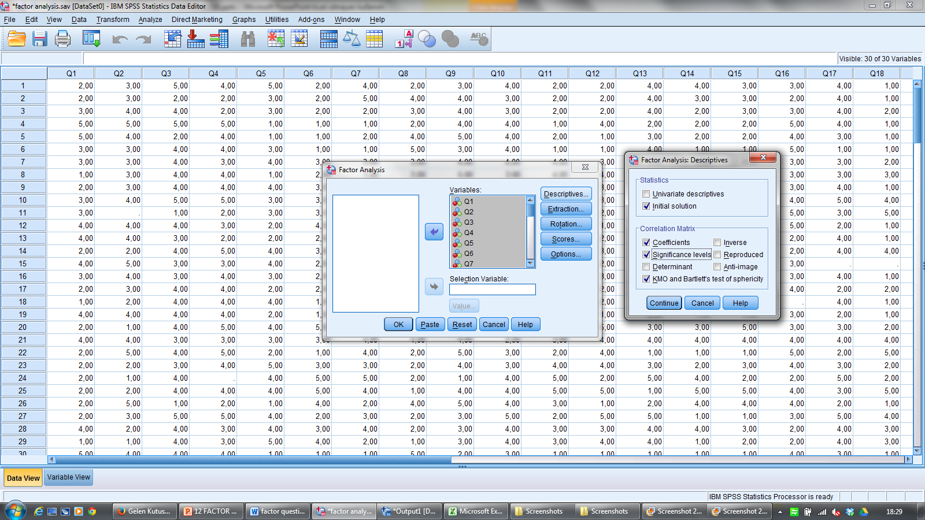

Slide 21
Step 4. Click Extraction
Select Scree Plot
Make sure
Method is Principal Component
Correlation matrix is checked
Eigenvalue is greater than 1
Click Continue

Slide 22
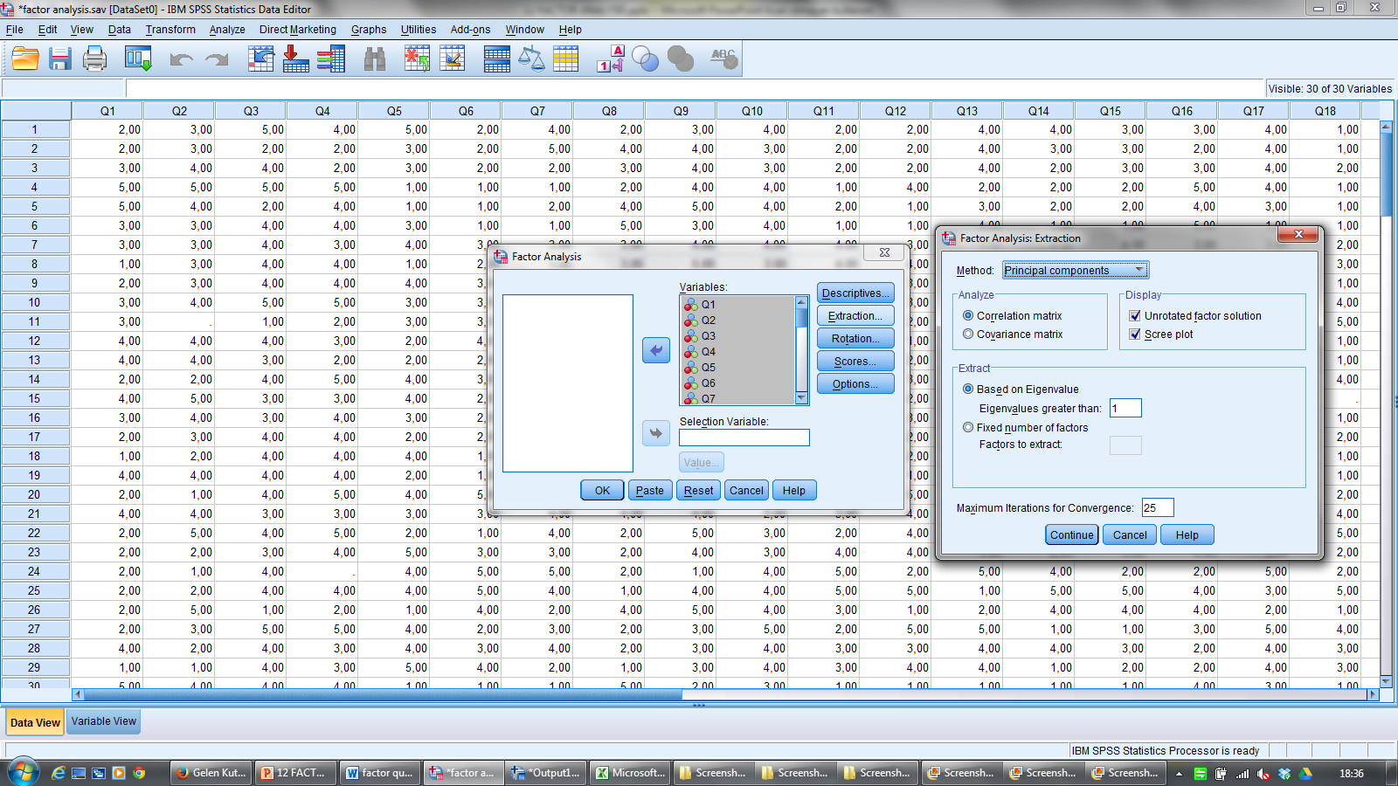

Slide 23
Step 5. Click Rotation
Select Varimax
Click Continue

Slide 24
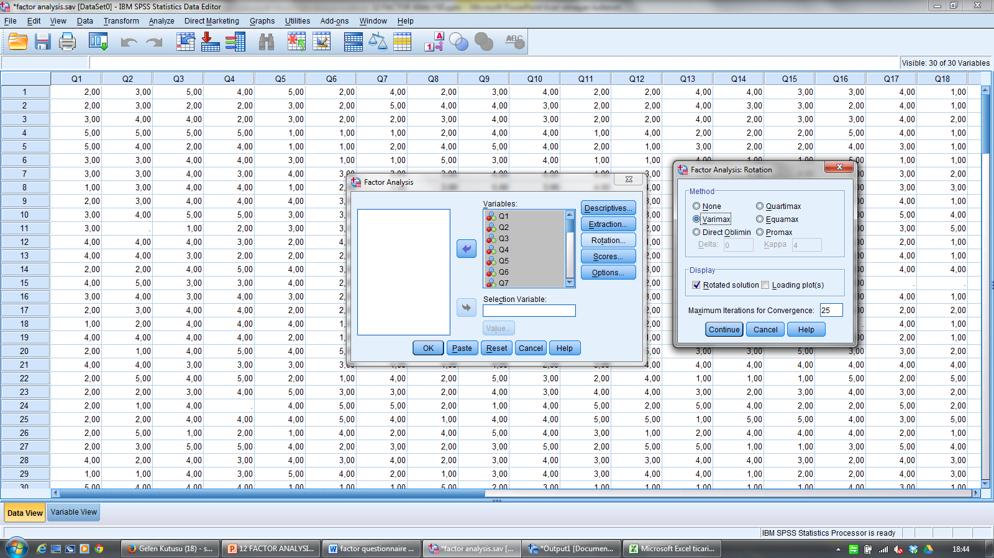

Slide 25
Step 6. Click Options
Select Sorted by Size
Make sure Exclude cases listwise is selected
Click continue

Slide 26
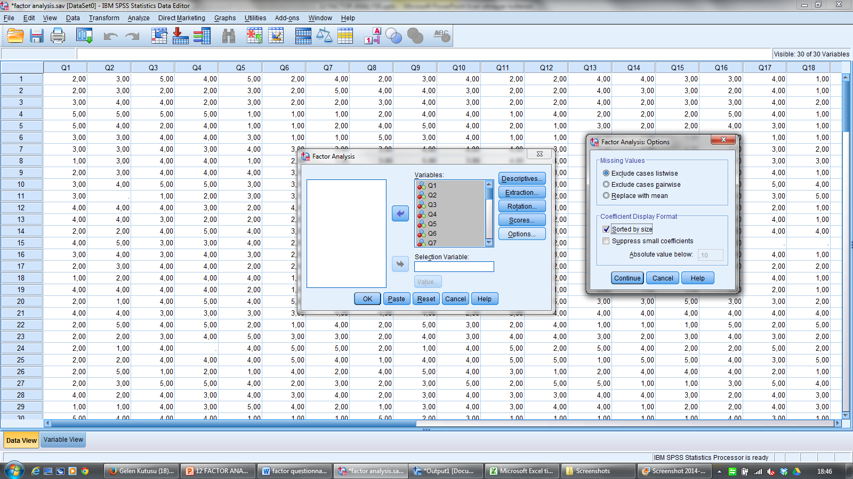

Slide 27
Step 7: Click OK
You will see the analysis results as Output document
A) Correlation matrix

Slide 28
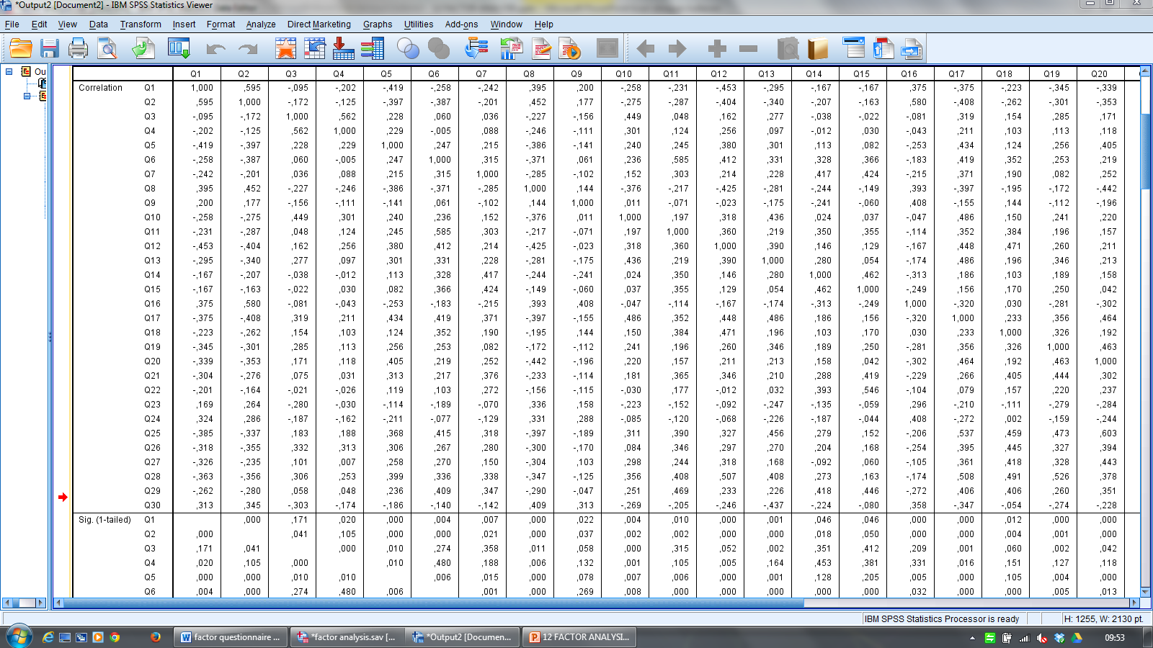

Slide 29
Analysing correlation matrix
If a variable has no relationship with any other variable, it should be taken out .
If a variable has a correlation of .9 or above (perfect correlation) with another variable, you should consider taking it out.

Slide 30
B) KMO & Barlett’s Test
KMO and Bartlett's Test
Kaiser-Meyer-Olkin Measure of Sampling Adequacy. |  | ,804
Bartlett's Test of Sphericity | Approx. Chi-Square | 1404,825
 | df | 435
 | Sig. | ,000
KMO shows the suitability of your data for factor analysis.
0,93 shows that this data is perfect.
Above 0,8 very good
0,7-0,8 good,
0,5-0,7 medium,
below 0,5, you should collect more data
Bartlett shows the significance.

Slide 31
C) Commonalities
Communalities
 | Initial | Extraction
Q1 | 1,000 | ,665
Q2 | 1,000 | ,729
Q3 | 1,000 | ,801
Q4 | 1,000 | ,804
Q5 | 1,000 | ,538
Q6 | 1,000 | ,707
Q7 | 1,000 | ,567
Q8 | 1,000 | ,635
Q9 | 1,000 | ,498
Q10 | 1,000 | ,753
Q11 | 1,000 | ,619
Q12 | 1,000 | ,731
Q13 | 1,000 | ,753
Q14 | 1,000 | ,673
Q15 | 1,000 | ,717
Q16 | 1,000 | ,730
Q17 | 1,000 | ,664
Q18 | 1,000 | ,760
Q19 | 1,000 | ,743
Q20 | 1,000 | ,784
Q21 | 1,000 | ,691
Q22 | 1,000 | ,717
Q23 | 1,000 | ,786
Q24 | 1,000 | ,702
Q25 | 1,000 | ,764
Q26 | 1,000 | ,772
Q27 | 1,000 | ,689
Q28 | 1,000 | ,677
Q29 | 1,000 | ,626
Q30 | 1,000 | ,647
Extraction Method: Principal Component Analysis.
This shows the common variances.
We understand to what extent the variance after factor extraction is common.
E.g. For Question 1, 66% of the variance is common. Some info is missing.
The present factors cannot explain all the variance

Slide 32
D) Total Variance Explained
Eigenvalues before and after rotation.
There are 9 factors with eigenvalues bigger than 1.
The first factor covers 29% of the variance.
Rotation equals the importance of the factors
Factor 1’s contribution reduces to 10% from 29%.
The 9 factors explain about 70% of the total variance

Slide 33
D) Total Variance Explained
Eigenvalues before and after rotation.
There are 9 factors with eigenvalues bigger than 1.
The first factor covers 29% of the variance.
Rotation equals the importance of the factors
Factor 1’s contribution reduces to 10% from 29%.
The 9 factors explain about 70% of the total variance

Slide 34
D) Total Variance Explained
Eigenvalues before and after rotation.
There are 9 factors with eigenvalues bigger than 1.
The first factor covers 29% of the variance.
Rotation equals the importance of the factors
Factor 1’s contribution reduces to 10% from 29%.
The 9 factors explain about 70% of the total variance

Slide 35
D) Total Variance Explained
Eigenvalues before and after rotation.
There are 9 factors with eigenvalues bigger than 1.
The first factor covers 29% of the variance.
Rotation equals the importance of the factors
Factor 1’s contribution reduces to 10% from 29%.
The 9 factors explain about 70% of the total variance

Slide 36
D) Total Variance Explained
Eigenvalues before and after rotation.
There are 9 factors with eigenvalues bigger than 1.
The first factor covers 29% of the variance.
Rotation equals the importance of the factors
Factor 1’s contribution reduces to 10% from 29%.
The 9 factors explain about 70% of the total variance

Slide 37
E) Component Matrix (factor loads)
Normally loadings bigger than 0,3 are accepted to be important
But the number of the sampling is also important
For 50 : 0,722
For 100: 0,512
For 200: 0,364
For 300: 0,298
For our data (150 participants) we can accept 0,40.
To analyze the loadings let’s look at the component matrix first

Slide 38
Component Matrixª
 | Component
 | 1 | 2 | 3 | 4 | 5 | 6 | 7 | 8 | 9
Q25 | ,736 | -,001 | ,145 | -,100 | ,135 | -,256 | -,001 | ,325 | -,048
Q28 | ,725 | -,071 | ,218 | ,120 | ,072 | -,173 | -,135 | ,088 | ,152
Q17 | ,715 | -,156 | ,109 | ,010 | -,132 | ,038 | ,179 | ,254 | -,042
Q2 | -,642 | ,119 | ,166 | ,282 | ,216 | -,201 | ,115 | ,304 | -,047
Q26 | ,641 | -,081 | -,030 | ,150 | ,261 | -,310 | -,353 | -,105 | -,179
Q8 | -,629 | ,180 | ,098 | ,113 | ,183 | -,184 | -,078 | ,067 | ,328
Q1 | -,616 | ,102 | ,097 | ,284 | ,083 | -,317 | ,232 | ,073 | -,138
Q29 | ,616 | ,421 | ,030 | ,028 | ,058 | -,113 | ,085 | ,051 | -,203
Q20 | ,609 | -,090 | ,000 | -,383 | ,353 | -,033 | ,145 | ,244 | -,230
Q12 | ,597 | -,045 | ,315 | ,014 | -,317 | ,218 | -,260 | -,102 | ,217
Q19 | ,584 | -,006 | ,081 | -,113 | ,402 | -,111 | ,155 | -,148 | ,403
Q6 | ,569 | ,279 | ,159 | ,026 | -,473 | -,151 | ,072 | -,114 | -,121
Q13 | ,567 | -,213 | ,034 | ,140 | -,235 | -,124 | ,286 | ,161 | ,432
Q5 | ,557 | -,147 | ,041 | -,150 | -,005 | ,358 | -,112 | ,196 | -,048
Q11 | ,556 | ,334 | ,115 | ,210 | -,274 | -,184 | -,145 | -,058 | -,086
Q21 | ,556 | ,426 | ,027 | -,026 | ,285 | ,230 | -,016 | -,077 | ,243
Q30 | -,514 | ,377 | ,360 | -,153 | ,090 | ,178 | ,040 | -,023 | -,215
Q18 | ,503 | ,256 | ,487 | ,039 | ,110 | -,208 | -,321 | -,191 | ,088
Q7 | ,485 | ,337 | -,147 | ,186 | -,115 | ,105 | ,050 | ,297 | -,216
Q27 | ,482 | ,057 | ,475 | -,430 | ,122 | -,002 | ,095 | ,045 | -,128
Q10 | ,476 | -,298 | ,314 | ,209 | -,141 | ,234 | ,468 | ,032 | ,026
Q15 | ,380 | ,614 | -,265 | ,255 | ,021 | ,143 | ,092 | -,174 | -,036
Q22 | ,302 | ,564 | -,281 | ,083 | ,367 | ,277 | ,089 | ,001 | ,056
Q3 | ,367 | -,500 | ,138 | ,478 | ,294 | ,116 | ,155 | -,195 | -,077
Q9 | -,256 | ,214 | ,577 | -,026 | -,161 | ,011 | ,000 | -,107 | -,129
Q16 | -,483 | ,109 | ,567 | ,299 | ,075 | -,075 | -,009 | ,242 | ,062
Q24 | -,404 | ,385 | ,449 | -,002 | ,041 | ,237 | ,299 | -,196 | ,056
Q14 | ,434 | ,405 | -,447 | ,246 | -,142 | -,130 | ,120 | ,078 | ,057
Q4 | ,298 | -,388 | ,114 | ,525 | ,201 | ,342 | -,234 | -,046 | -,249
Q23 | -,381 | ,230 | ,081 | ,088 | -,066 | ,339 | -,373 | ,519 | ,214
Extraction Method: Principal Component Analysis.
a. 9 components extracted.
Before rotation, most variables are related to the first factor (the ones over 0,40)
You can also see this in the scree plot

Slide 39
F) Scree Plot

Slide 40
To see the common themes of the variables under each factor, we should check the loadings after rotation
Let’s accept the ones loading above 0,40

Slide 41
Rotated Component Matrixª
 | Component
 | 1 | 2 | 3 | 4 | 5 | 6 | 7 | 8 | 9
Q15 | ,813 | ,141 | ,108 | -,093 | ,030 | -,015 | ,014 | ,075 | -,095
Q22 | ,746 | -,094 | ,075 | ,116 | ,018 | -,144 | ,035 | ,323 | ,082
Q14 | ,684 | ,141 | ,006 | -,047 | -,346 | ,190 | -,144 | -,047 | -,071
Q7 | ,589 | ,151 | ,094 | ,265 | -,117 | ,172 | ,061 | -,235 | ,128
Q29 | ,550 | ,367 | ,073 | ,393 | -,008 | ,085 | -,010 | ,004 | -,142
Q21 | ,528 | ,208 | ,276 | ,198 | ,071 | ,043 | ,046 | ,487 | ,086
Q18 | ,085 | ,770 | ,105 | ,182 | ,154 | -,016 | ,089 | ,291 | -,011
Q11 | ,391 | ,624 | ,133 | ,055 | -,043 | ,175 | -,002 | -,140 | -,066
Q26 | ,137 | ,555 | ,088 | ,291 | -,421 | -,143 | ,326 | ,117 | -,186
Q28 | ,096 | ,541 | ,151 | ,317 | -,241 | ,314 | ,202 | ,233 | ,018
Q6 | ,318 | ,526 | ,263 | ,100 | ,077 | ,339 | -,146 | -,240 | -,225
Q2 | -,111 | -,177 | -,749 | -,093 | ,201 | -,116 | -,006 | -,078 | ,233
Q1 | -,093 | -,145 | -,718 | -,196 | ,199 | -,088 | -,050 | -,169 | -,065
Q12 | ,011 | ,500 | ,564 | ,018 | ,049 | ,335 | ,138 | ,080 | ,147
Q16 | -,231 | ,114 | -,559 | -,093 | ,450 | ,049 | ,091 | -,024 | ,358
Q8 | -,172 | -,079 | -,513 | -,333 | ,151 | -,189 | -,210 | ,231 | ,263
Q5 | ,091 | ,056 | ,503 | ,391 | -,110 | ,169 | ,214 | ,014 | ,185
Q20 | ,116 | ,004 | ,198 | ,805 | -,190 | ,040 | ,055 | ,148 | -,146
Q25 | ,153 | ,406 | ,068 | ,645 | -,272 | ,261 | ,033 | ,107 | -,004
Q27 | -,056 | ,276 | ,254 | ,642 | ,281 | ,114 | -,052 | ,158 | -,114
Q24 | ,059 | -,120 | -,179 | -,159 | ,776 | ,000 | -,085 | ,133 | ,011
Q30 | -,024 | -,124 | -,199 | ,011 | ,665 | -,326 | -,134 | -,087 | ,131
Q9 | -,163 | ,232 | -,116 | -,039 | ,615 | -,028 | -,062 | -,136 | ,037
Q13 | ,053 | ,182 | ,125 | ,080 | -,294 | ,757 | -,011 | ,185 | -,034
Q10 | ,026 | -,002 | ,178 | ,207 | ,148 | ,700 | ,378 | ,005 | -,153
Q17 | ,151 | ,201 | ,266 | ,454 | -,179 | ,513 | ,158 | -,057 | -,029
Q4 | ,006 | ,109 | ,137 | ,018 | -,106 | ,019 | ,864 | -,075 | ,097
Q3 | -,059 | ,037 | -,005 | ,057 | -,125 | ,274 | ,781 | ,169 | -,250
Q19 | ,131 | ,198 | ,132 | ,281 | -,148 | ,231 | ,050 | ,689 | -,195
Q23 | ,005 | -,097 | -,082 | -,139 | ,128 | -,116 | -,094 | -,083 | ,840

Slide 43
Now it’s time to decide the factors, their labels, and the items under each factor.
After reviewing the literature, you have decided to group the items under these categories
External attribution: Assessment measures students future and intelligence or the quality of schooling
Improvement: Assessment improves students’ learning and teachers’ teaching
Irrelevance: Assessment is ignored or perceived negatively
Affect: Assessment is enjoyable and benefits the class environment
Now, look at the questionnaire items and factor loadings and decide the factors.
At this step, we may need some qualitative decisions as well.
See which items can be grouped under the lables
(if you don’t have previously decided labels, you also need to decide the lables of the factos)
If there are some unrelated items, see whether it can fit in another factor.

Slide 44
References
yunus.hacettepe.edu.tr/~tonta/courses/spring2008/bby208/
Büyüköztürk, Ş. (2009). Sosyal Bilimler İçin Veri Analizi El Kitabı, Ankara:Pegem Akademi
http://www.hawaii.edu/powerkills/UFA.HTM

